Slide 1
VEDIC MULTIPLIER
By
M.M.RAJU(14A31A04N1)
V.B.S.MANIKANTA(14A31A04O0)
A.RAMAKRISHNA(14A31A04L6)
G.SRI MAHARSHI(14A31A04M0)

Slide 2
1.Introduction to multipliers
Multipliers are extensively used in Microprocessors, DSP and Communication applications. For higher order Multiplications, a huge number of adders are to be used to perform the partial product addition. The need of low power and high speed Multiplier is increasing as the need of high speed processors are increasing.

Slide 3
2.Introduction to Vedic multipliers
The Vedic multiplication technique is based on 16 Vedic sutras or aphorisms, which are actually word formulae describing natural ways of solving a whole range of mathematical problems. The mathematical operations using, Vedic Method are very fast and requires less hardware, this can be used to improve the computational speed of processors.

Slide 4
Vertical and cross wise technique
The proposed Vedic multiplier is based on the “Urdhv Tiryakbhyam” sutra (algorithm). These Sutras have been traditionally used for the multiplication of two numbers in the decimal number system.
The Multiplier based on this sutra has the advantage that as the number of bits increases, gate delay and area increases very slowly as compared to other conventional multipliers.

Slide 5
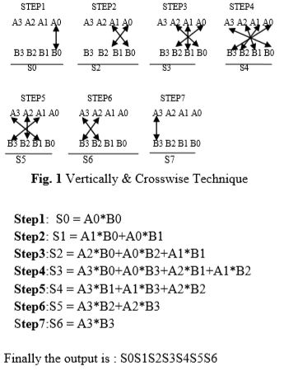

Slide 6
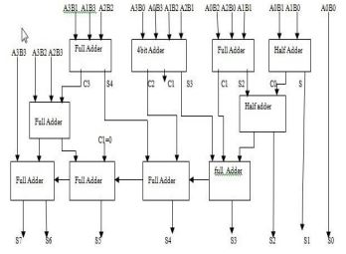
BLOCK DIAGRAM OF 4*4 VEDIC MULTIPLIER

Slide 7
CONCLUSION:
The design of the 4x4 bit Vedic multiplier is Implemented on T-Spice v13.0.
It is a method for hierarchical multiplier design which clearly indicates the computational advantages offered by Vedic methods.
Using CMOS logic computational path delay is found to be 0.40ns but for multiplier using conventional method (Array) computational path delay is found to be 25.3ns. Hence it can be concluded that the performance of the 4x4 bit Vedic multiplier seems to be highly efficient in terms of speed when compared to Array multipliers.
Reducing the time delay is very essential requirement for many applications and Vedic Multiplication technique is very much suitable for this purpose.

Slide 8
REFERENCES:
1. “Pushpalata Verma, K. K. Mehta” Implementation of an Efficient Multiplier based on Vedic Mathematics Using EDA Tool” International Journal of Engineering and Advanced Technology (IJEAT) ISSN: 2249 – 8958, Volume-1, Issue-5, June 2012
2. IEEE Journal of Solid-State Circuits, vol. 17, no. 5, October 1982, pp. 898-90
3. Tanner EDA Inc 1988, User’s Mannual,2005

Slide 9
THANK YOU

